Slide 1

Fake News and Misinformation on Social Media
Madhu Sharma(2401010103),
Tanisq Goel(),
Adars Rai (2401010018),
Vaibhav Goel(2401010288)
Under Supervison of
Internal: Deepak Kaushik
School of Engineering and Technology

Slide 2

Fake News and Misinformation on Social Media
Understanding the Impact and How to Combat It

Slide 3
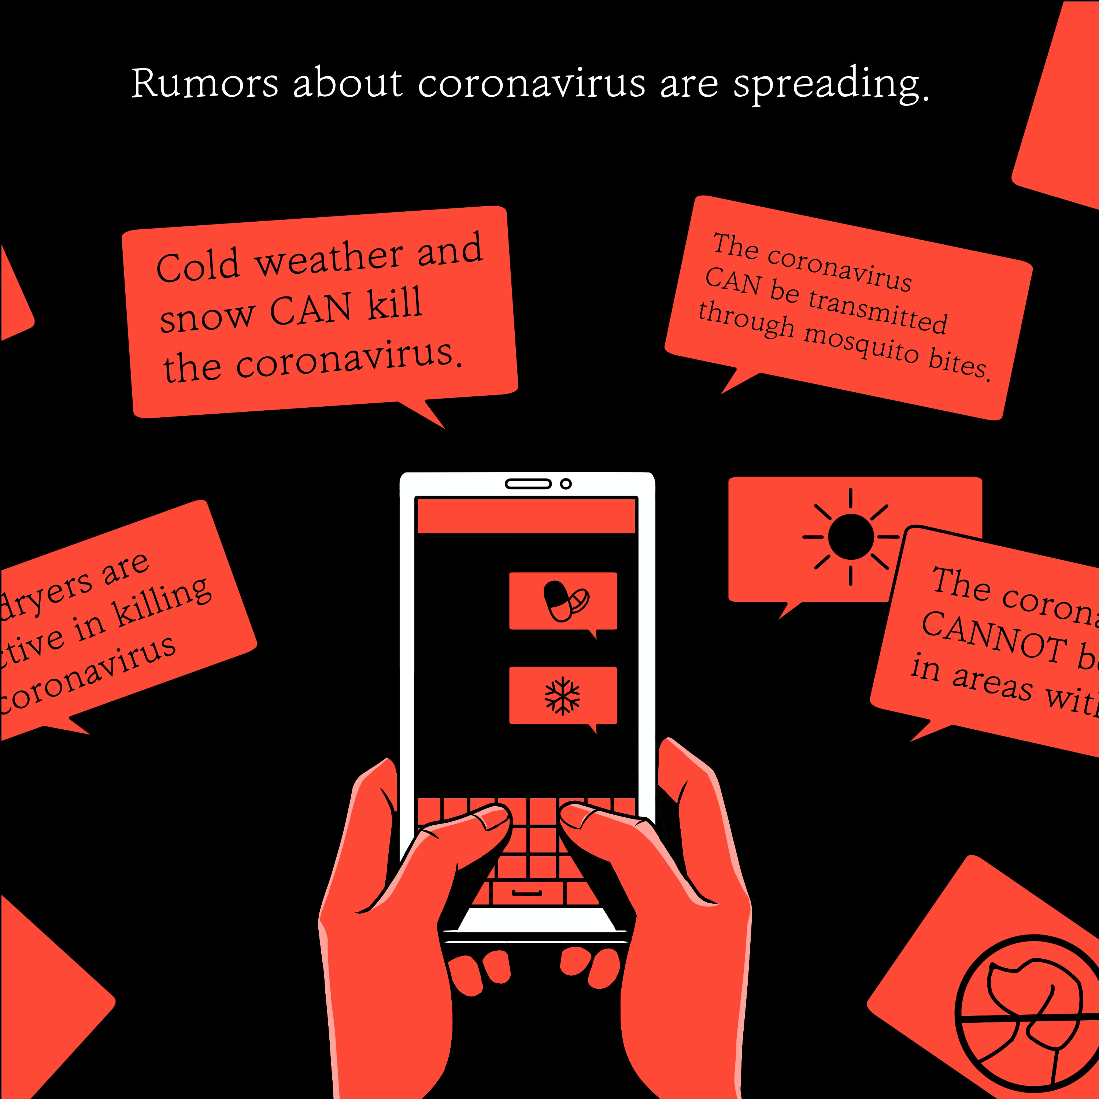
What is misinformation?
Misinformation is false information that is spread by people who think it's true. This is different from 'fake news' and disinformation.
Fake news refers to websites that share mis or disinformation. This might be via satire sites like the onion, but it also refers to those pretending to be trustworthy news sources.
Sometimes, people use the term ‘fake news’ to discredit true information. As such, it’s better to use more general terms such as ‘misinformation’ and ‘disinformation’.
Disinformation is false information that someone or a group spreads online while knowing it’s false. Generally, they do this for a specific intention, usually for the purpose of influencing others to believe their point of view.
This Photo by Unknown Author is licensed under CC BY-NC

Slide 4
What impact can fake news have on young people?
Scams: falling for scams could lead to data breaches, financial loss, impacts on credit score and more.
Harmful belief systems: if children watch content that spreads hate, this can become a part of their worldview. This could lead to mistreatment of people different from them or even lead to radicalisation and extremism.
Dangerous challenges or hacks: some videos online might promote dangerous challange or ‘life hacks’ that can cause serious harm. These hacks are common in videos from content farm.
Confusion and distrust: If a child becomes a victim of dis or misinformation, they might struggle with new information. This can lead to distrust, confusion and maybe anxiety, depending on the extent of the misinformation.

Slide 5
Research into misinformation and fake news
Below are some figures into how misinformation can affect children and young people.
According to Ofcom, 79% of 12-15-year-olds feel that news they hear from family is ‘always’ or ‘mostly’ true.
6 in 10 parents worry about their child ‘being scammed/defrauded/lied to/impersonated’ by someone they didn’t know.
28% of children aged 12-15 use TikTok as a news source (Ofcom).
Around 4 in 10 children aged 9-16 said they experienced the feeling of ‘being unsure about whether what I see is true’. This was the second most common experience after ‘spending too much time online’.
NewsWise from The National Literacy Trust helped children develop their media literacy skills. Over that time, the children able to accurately assess news as false or true increased from 49.2% to 68%. This demonstrates the importance of teaching media literacy.

Slide 6
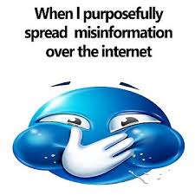
To better understanding misinformation in social media, we organize different types of misinformation below, though the categorization is not exclusive.
Unintentionally-Spread Misinformation:
Some misinformation is unintentional to deceive its recipients. Regular and benign users may contribute to the propagation merely due to their trust of information sources, such as their friends, family, colleagues or influential users in the social network. Instead of wanting to deceive, they usually try to inform their social network friends of a certain issue or situation. An example is the widespread misinformation about Ebola.
• Intentionally-Spread Misinformation:
Some misinformation is intentionally spread to deceive its recipients, which has triggered the intensive discussion about misinformation and fake news recently. There are usually writers and coordinated groups of spreaders behind the popularity, who have a clear goal and agenda to compile and promote the misinformation. For example, a fake-news writer, Paul Horner6 , has claimed credits for several pieces of fake news that went viral in 2017.

Slide 7

• Urban Legend :-Urban legend is intentionally-spread misinformation that is related to fictional stories about local events. The purpose can often be entertainment. • Fake News :-Fake news is intentionally-spread misinformation that is in the format of news. Recent incidents reveal that fake news can be used as propaganda and get viral through news media and social media. • Rumor :-Rumor is unverified information that can be true (true rumor). An example of true rumor is about deaths of several ducks in Guangxi, China, which were claimed to be caused by avian influenza7 . It had been a true rumor until it was verified to be true by the government8 . A similar example of avian influenza, which turned out to be false, was that some people had been infected through eating well cooked chicken.

Slide 8
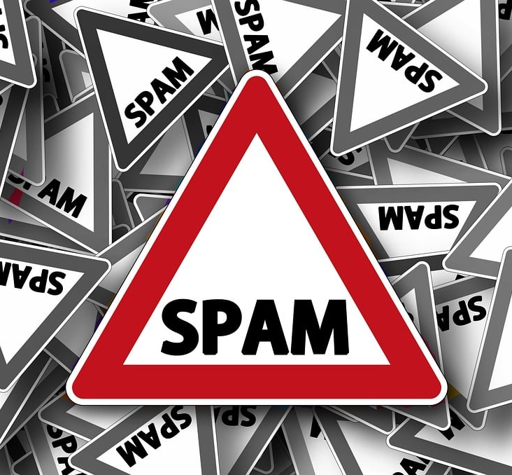
Crowdturfing :- Crowdturfing is a concept originated from astroturfing, which means the campaign masks its supporters and sponsors to make it appear to be launched by grassroots participants.
Spam :-Spam is unsolicited information that unfairly overwhelms its recipients. It has been found on various platforms including instant messaging, email and social media.
Troll :- Another kind of misinformation we focus on is troll. Troll aims to cause disruption and argument towards a certain group of people. Different from other types of misinformation that try to convince its recipients, trolling aims to increase the tension between ideas and ultimately to deepen the hatred and widen the gap.

Slide 9
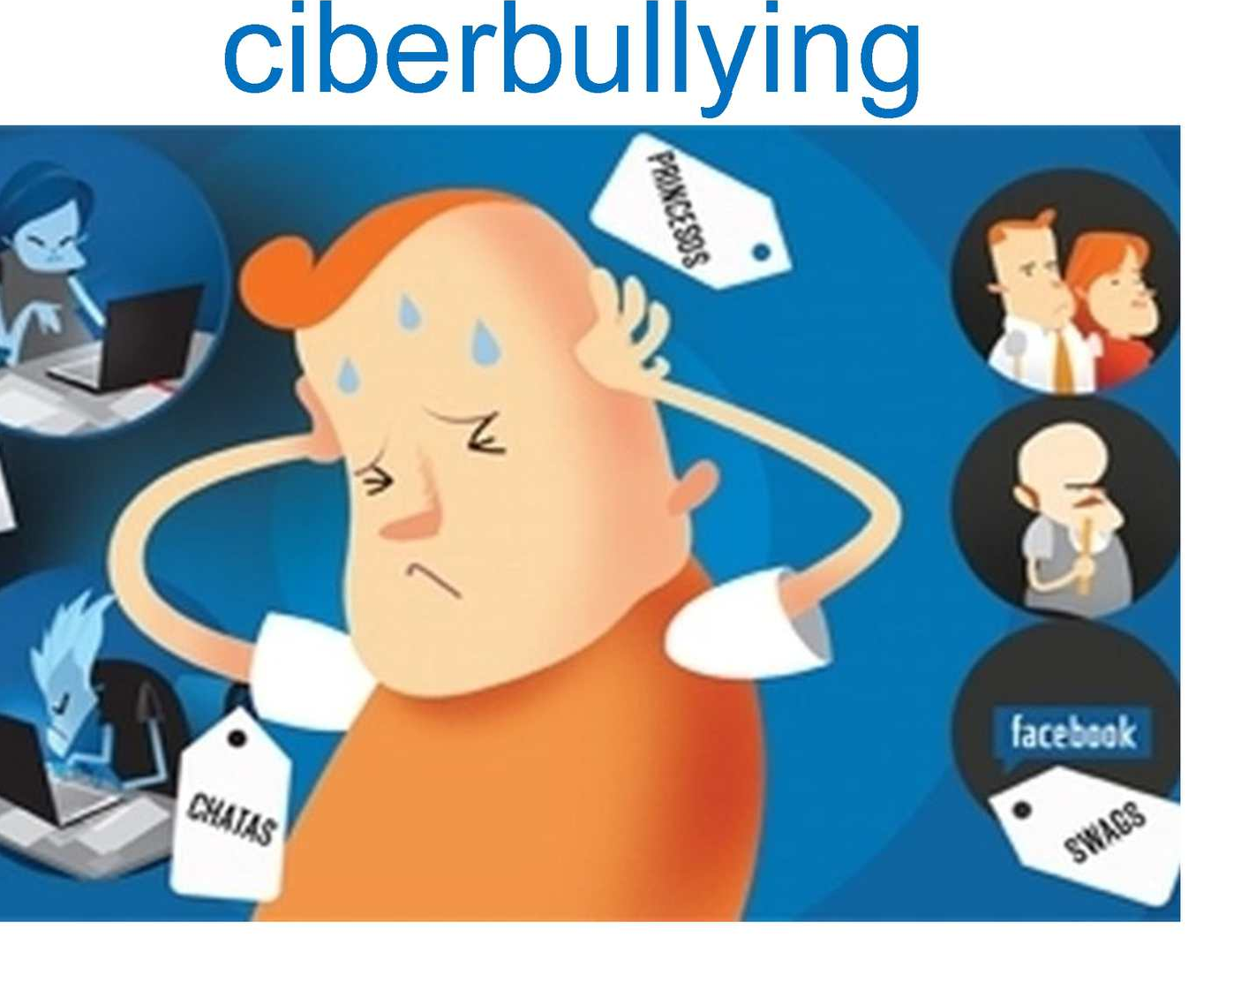
Hate speech :-Hate speech refers to abusive content on social media that targets certain groups of people, expressing prejudice and threatening. A dynamic interplay was found between the 2016 presidential election and hate speech against some protected groups, and the peak of hate speech was reached during the election day.
Cyberbullying :- Cyberbullying is a form of bullying happening online, usually in social media, that may consist of any form of misinformation, such as rumor and hate speech.

Slide 10
MANIPULATION OF MISINFORMATION
There are different types of spreaders and we focus on those who spread misinformation in social networks, and our research particularly focuses on those who spread it on purpose. Traditional approaches mainly focus on their excessive suspicious content and network topology, which obviously distance themselves from normal users.
Manipulation of Networks :-Since many users follow back when they are followed by someone for the sake of courtesy, misinformation spreaders could establish a decent number of links with legitimate users [37]. These noisy links no longer reflects homophily between two nodes, which undermine the performance of existing approaches. In addition, misinformation spreaders may even form a group by connecting with each other, and such coordinated behaviors are particularly challenging for a traditional method.
Manipulation of Content :-It is easy for a misinformation spreader to copy a significant portion of content from legitimate accounts. The misinformation that they intend to spread is camouflaged by the legitimate messages to avoid being detected. Traditional approaches merge posts of an account altogether as an attribute vector, which would be less distinguishable to capture the signal of misinformation.

Slide 11
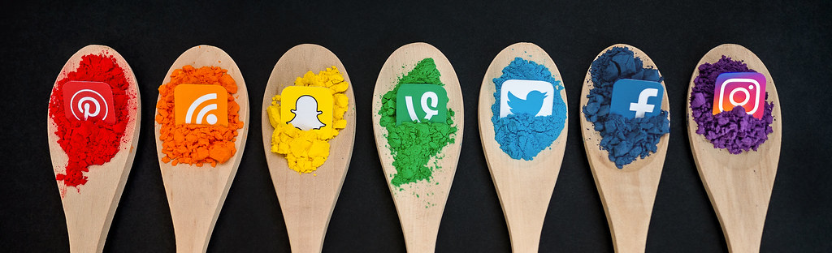
The Role of Social Media Platforms
Discuss major platforms (Facebook, Twitter, Instagram, TikTok) and their role in spreading misinformation.
Mention how these platforms have been criticized for not doing enough to control fake news.
Example: Facebook’s issues with political misinformation during elections.

Slide 12

Consequences of Fake News and Misinformation
Public Health: Misinformation about vaccines, COVID-19, and other health topics leading to harmful consequences.
Politics: Fake news can influence elections and public opinion (e.g., misinformation in political campaigns).
Social Impact: Erosion of trust in media and public institutions.
This Photo by Unknown Author is licensed under CC BY-NC

Slide 13
Examples of Fake News Campaigns
Highlight a few notorious examples of fake news, such as:
The “Pizzagate” conspiracy theory.
False claims about election rigging in 2020.
Anti-vaccine misinformati

Slide 14

How to Identify Fake News
Check the Source: Is the website reliable? Is the author credible?
Cross-Verify: Look for other reputable sources reporting the same information.
Check Dates: Ensure the news is current and not outdated or manipulated.
Read Beyond the Headline: Headlines can be misleading; always read the full article.

Slide 15

Conclusion
Recap the importance of understanding fake news and misinformation.
01
Emphasize personal responsibility and how we can all help mitigate the spread.
02
Call to action: Encourage the audience to share accurate information and be critical consumers of news.
03

Slide 16

THANK YOU

